Slide 2
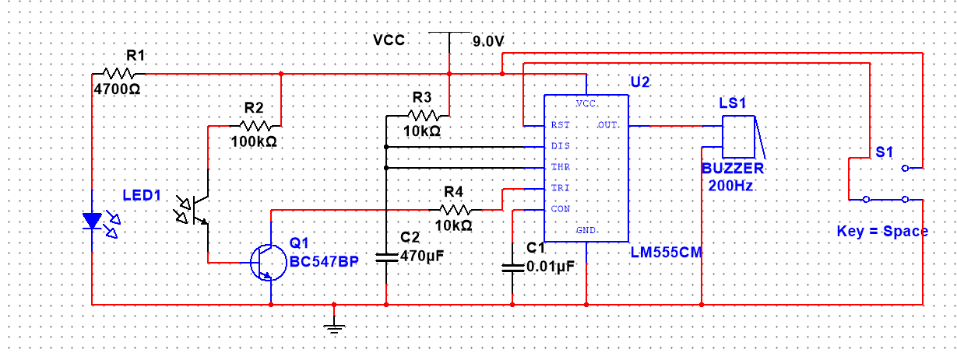
Automatic Door bell
Doorbell is a very common and useful device used in every household
Components:
LM555 Timer IC
Capacitors (470uF, 0.01uF)
Resistors (4.7k, 10k ,100k)
Buzzer
SPDT Switch
LED_IR
Phototransistor
BJT transistor (BC547BP)

Slide 3
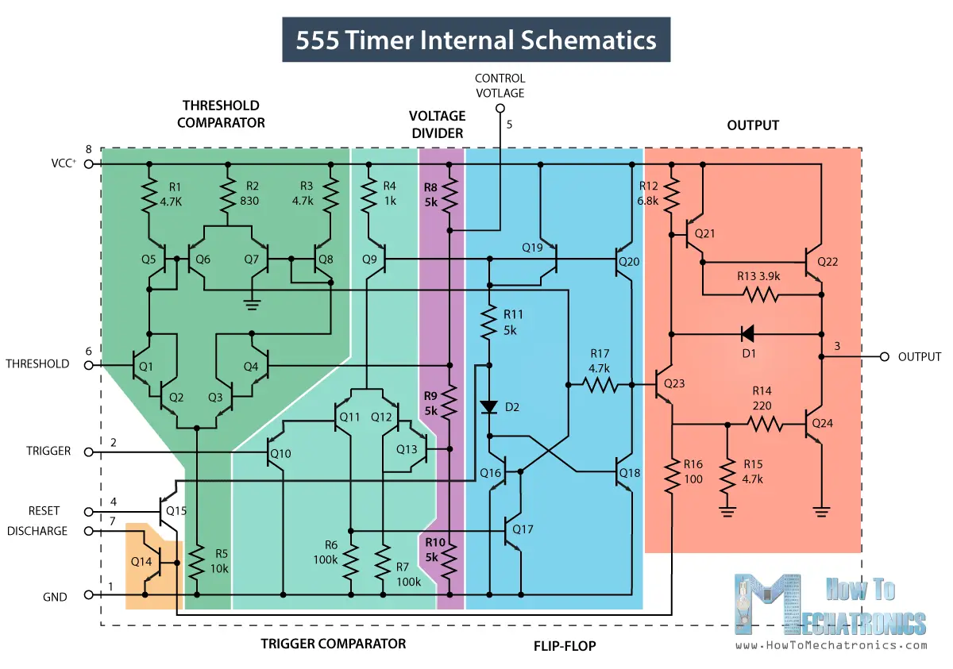
LM555 Timer IC
How It Works, Internal Schematic and Block Diagram
The internal schematics of 555 Timer which consists of 25 transistors, 2 diodes and 15 resistors.

Slide 4
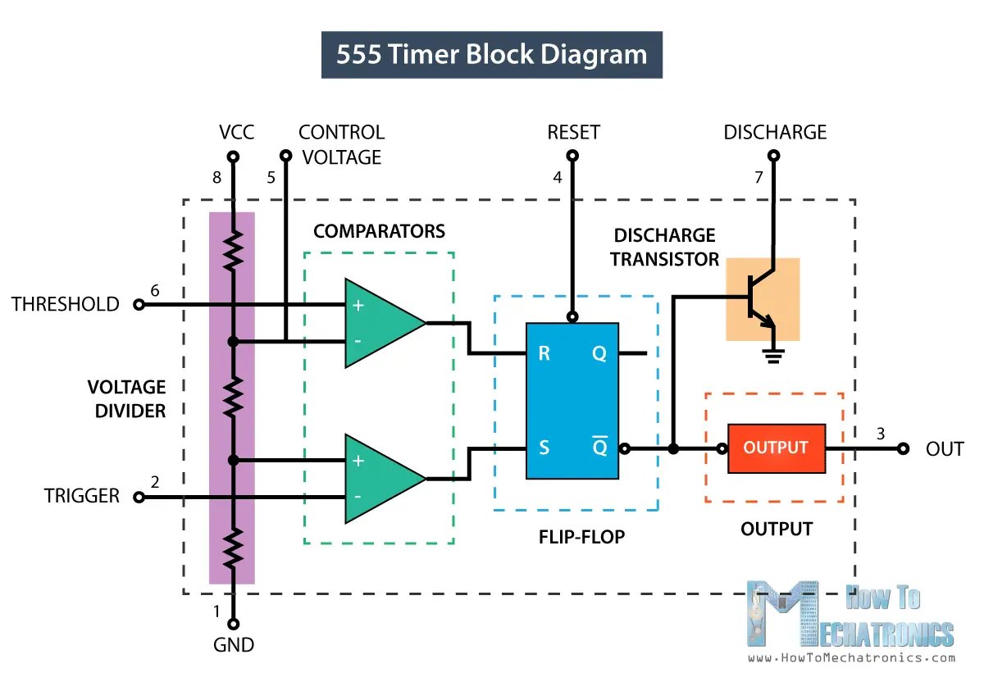
A block diagram it consists of 2 comparators, a flip-flop, a voltage divider, a discharge transistor and an output stage.

Slide 5
The voltage divider consists of three identical 5k resistors which create two reference voltages at 1/3 and 2/3 of the supplied voltage.
A comparator : compares two analog input voltages
Has two input terminals: +ve (non-inverting)
-ve (inverting)
+ve I/p voltage > -ve i/p voltage => The comparator outputs 1
+ve I/p voltage < -ve i/p voltage => The comparator outputs 0
The threshold pin: connected to +ve terminal of the 1st comparator
The trigger pin: connected to the –ve terminal of the 2nd comparator
R-S Flip flop:
Reset pin: Reset the timing operation of the o/p when it is connected to the ground i.e: over rides the trigger
S | R | Q(t+1) | Q’(t=1)
0 | 0 | No change | No change
0 | 1 | 0 | 1
1 | 0 | 1 | 0
1 | 1 | Undefined | Undefined

Slide 6
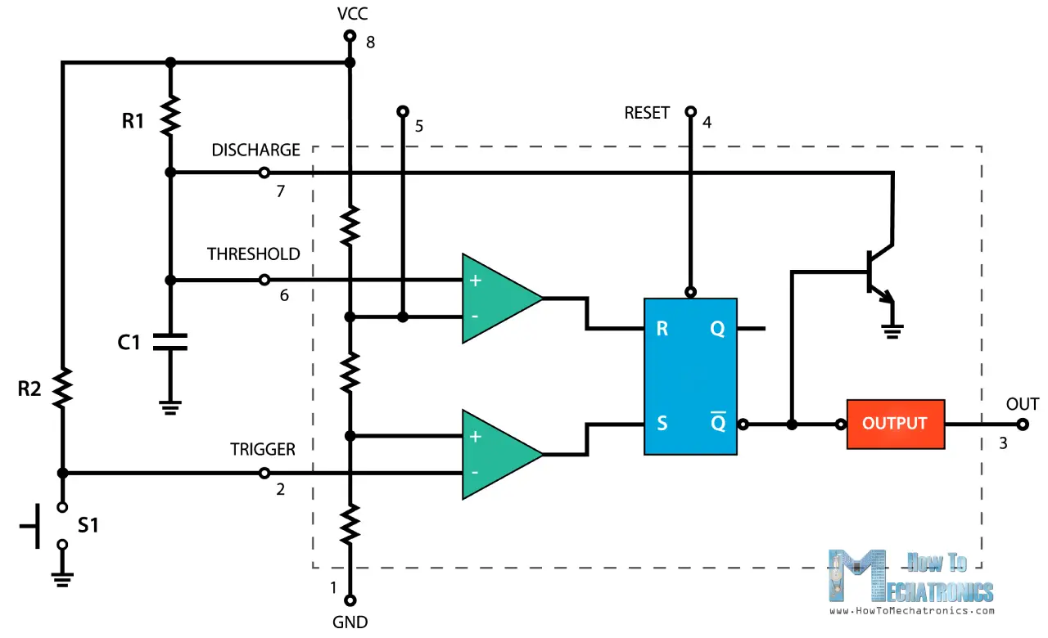
Control pin: Controls timing output independently . In our project not used.
When not in use, it is usually connected to ground via a 0.01 μF capacitor to prevent fluctuations in timing of the RC circuit.
Discharge pin : Open collector o/p which may discharge a capacitor during the operation.
The 555 Timer has three operating modes, bistable, monostable and astable mode.
In our project, the 555 timer operates in Monostable mode.

Slide 7
Pin 1 – Ground: Connected to 0 V
Pin 2 – Trigger: Turns on the output when the voltage supplied to it drops below 1/3 of Vcc.
Pin 3 – Output: Outputs up to 200 mA of current at about 1.5 V.
Pin 4 – Reset: Resets the timing operation of the output when it is connected to ground (0 V).
Pin 5 – Control: Controls timing output independently
Pin 6 – Threshold: Turns off the output when the voltage supplied to it reaches above 2/3 Vcc.
Pin 7 – Discharge: When output voltage is low, it discharges the capacitor in the RC circuit to ground.
Pin 8 – Vcc (supply voltage):

Slide 8
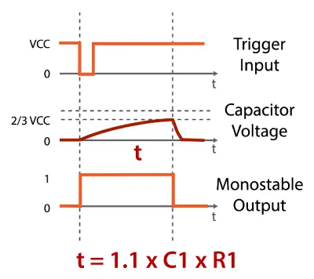
Assume initially O/p=0, i.e: Q’ =1, which activates the discharge transistor;
i.e: TH =0 => comp1=0 & TR =1 => comp2=0
NO change of state
When trigger i/p is applied; comp2 =1
Q=1,Q’=0, until C1 charges it self up to 2/3Vcc in time t.

